Slide 1
Data and time-series analysis with Deedle
Tomas Petricek
tomas@tomasp.net | @tomaspetricek
PhD Student at Cambridge & Coordinator of http://fsharp.org

Slide 2
software stacks trainings teaching F# user groups snippets mac and linux community books and tutorials
F# Software Foundation
consulting open-source MonoDevelop
http://www.fsharp.org
contributions research support cross-platform mailing lists

Slide 3
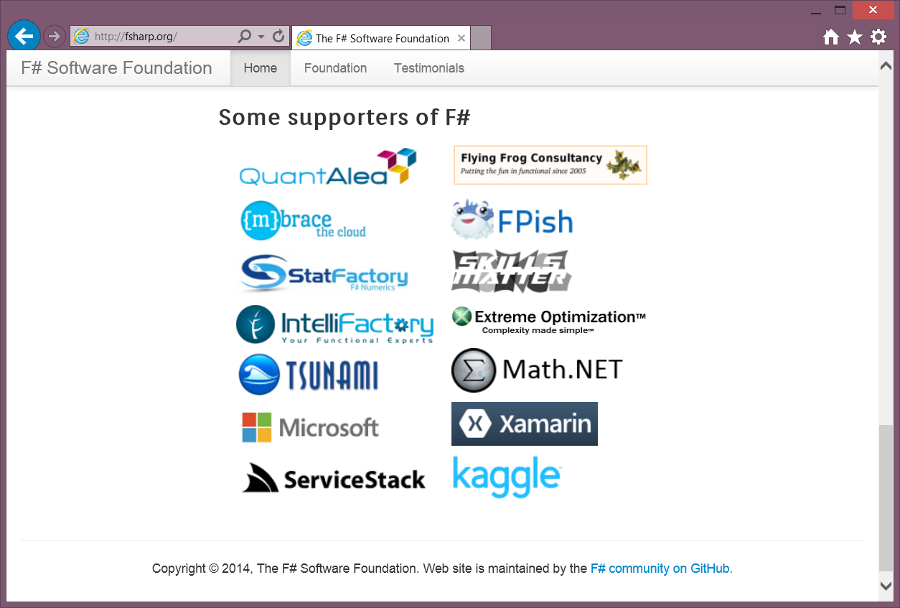

Collaboration matters!

Slide 4
data acquisition statistics data cleaning machine learning data transformation visualization type providers
F# Data Science Working Group
kaggle vega grammar data sources presentation
R provider visualization
www.fslab.org
time-series data aggregation

Slide 5
Acquire
Analyze
Visualize

Slide 6

Deedle is…
Exploratory data analysis
Time-series analysis
Data cleaning
Stats and visualization
(via other libraries)
http://bluemountaincapital.github.io/Deedle/

Slide 7
Deedle is...
3rd version @ BlueMountain
Open-source
Well documented
C# and F# friendly
Ready for contributors
http://bluemountaincapital.github.io/Deedle/

Slide 8
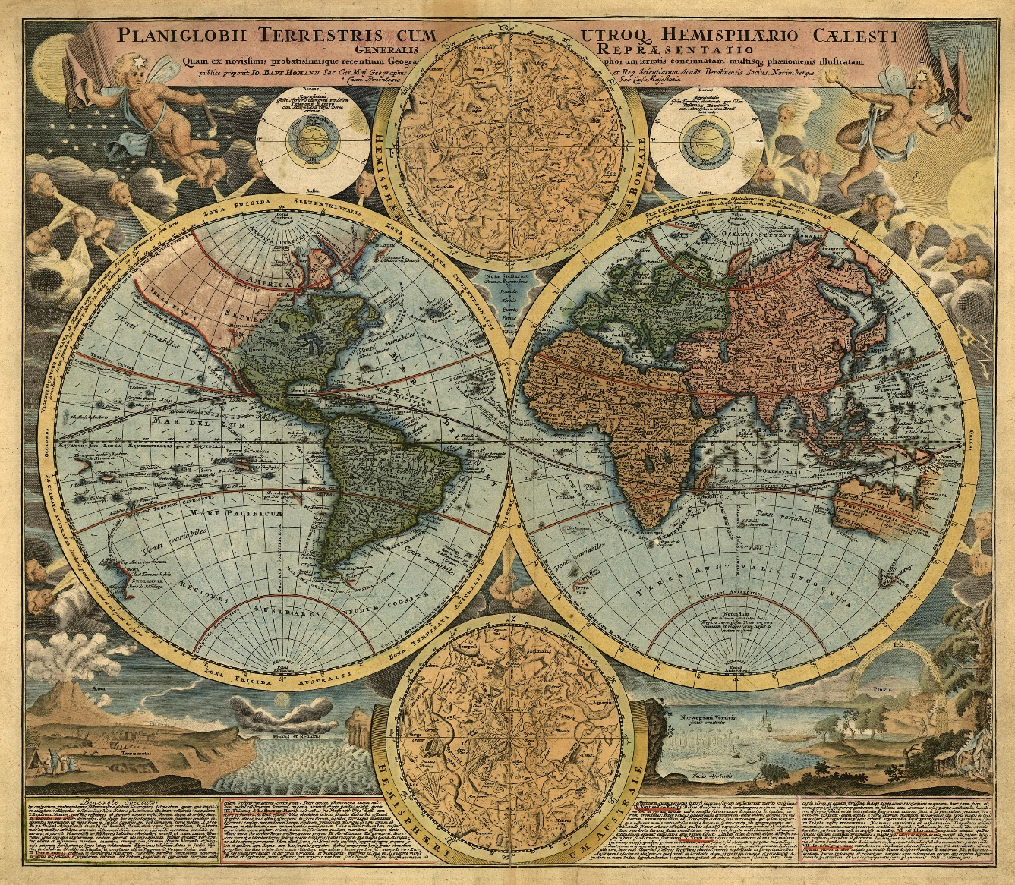
Demo: Understanding the world

Slide 9


F# Data type providers
First-class data
CSV, REST, WorldBank…
R Type provider
Statistics & visualization
5000 tested packages
www.fslab.org

Slide 10
Deedle series
Key → Value mapping
Immutable
Deedle frame
(RowKey, ColKey) → Value
Heterogeneous values
Column-wise mutable
http://bluemountaincapital.github.io/Deedle/

Slide 11

Demo: Analyzing Titanic survivors

Slide 12

Deedle data exploration
Interactive research
Indexing and aggregation
Pivot table functionality
F# Charting library
Interactive & composable
www.fslab.org

Slide 13
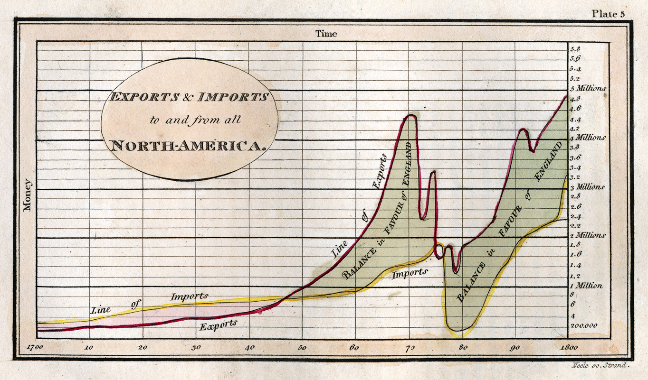
Demo: Analyzing stock prices

Slide 14
Deedle and stock prices
Time series alignment
Exploration & slicing & c.
First-class missing values
Statistical functions
Hierarchical indexing
Supports lazy loading
http://bluemountaincapital.github.io/Deedle/

Slide 15
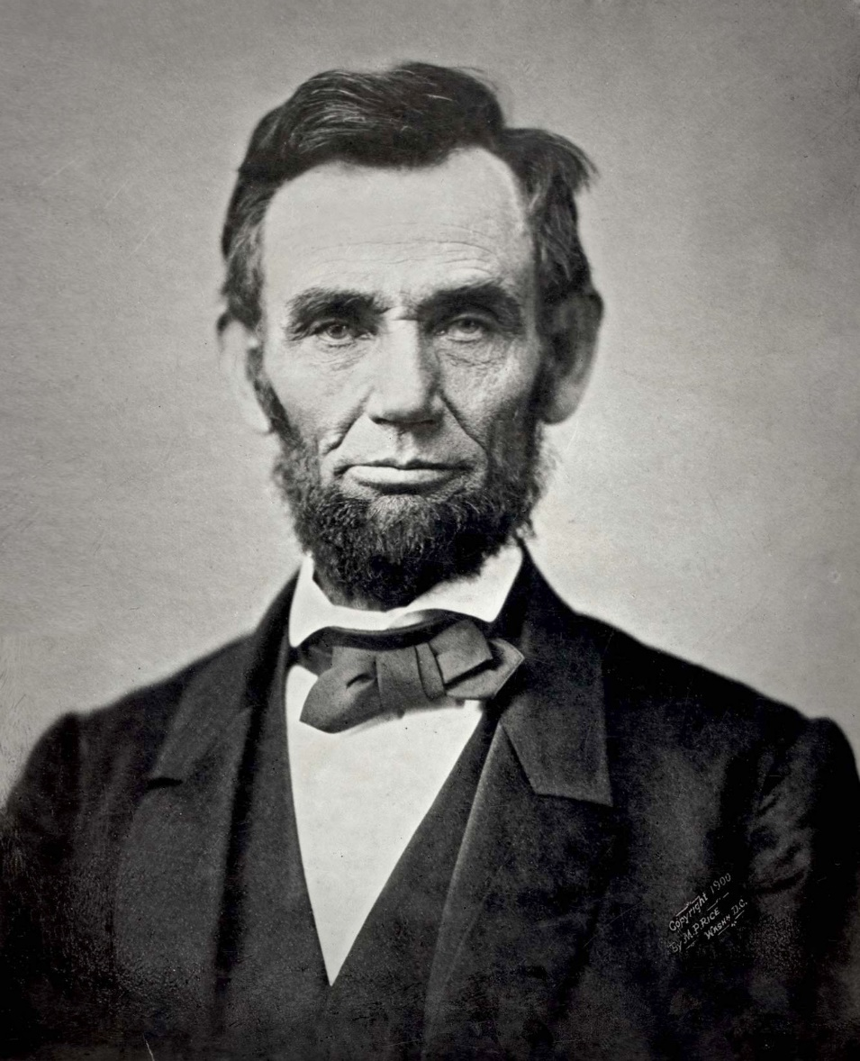
Demo: US debt over the last century

Slide 16

Deedle data analysis
Time-series alignment
Data transformations
Vega visualization
F# wrapper for Vega
Pre-alpha version
www.fslab.org

Slide 17
F# for Data Science
acquire, analyze, visualize
interactive experience
safety and efficiency of .net
ready for production
@tomaspetricek

Slide 18
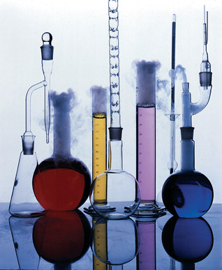
FsLab futures
FsLab needs you!
Visualization
Excel integration
Data sources
Linux & Mac support
Visual Studio extensions

Slide 19
Going forward
Come again in two weeks!
Use Deedle for fun & profit
Help us build data science tools
fsharp.org | fslab.org | tomasp.net
@tomaspetricek

